Slide 1


Team Presentation

Slide 2
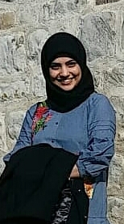
TEAM MEMBERS
Iffat Jamil
Current Semester:
2nd semester of Digital Engineering
Past Studies:
B.Eng. in Electronics Engineering
Skills:
Served as Customer Facing Technical resource in a private firm
Programming Language: Java
Personal motivation:
To learn App development skills
Implement and enhance my java skills
Enhance my interpersonal and communication skills

Slide 3
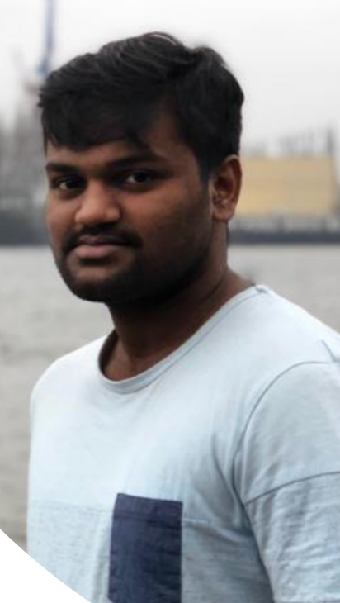
TEAM MEMBERS
Siva Matta
Current Semester:
2nd semester of Digital Engineering
Past Studies:
B.Eng. Mechanical Engineering
Skills:
AutoCAD, ProE (Software tools)
Programming Language: C, Will learn JAVA!
Personal motivation:
Allow myself to improve social skills
To learn how to work better in a team
Most importantly, get better in programming

Slide 4
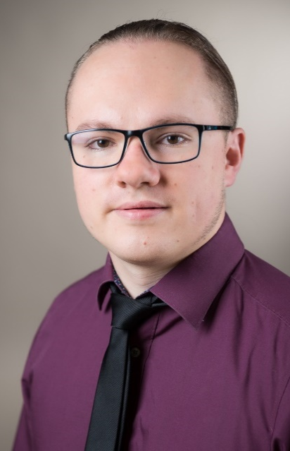
TEAM MEMBERS
Marcel Öfele
Current Semester:
2nd semester of Digital Engineering
Past Studies:
B.Eng. Mechanical Engineering
Skills:
minor experience with SCRUM
1 year of experience as project leader
programming skills: java, python
Personal motivation:
learning more about Software Development in general
learning more about agile methods
applying programming skills

Slide 5
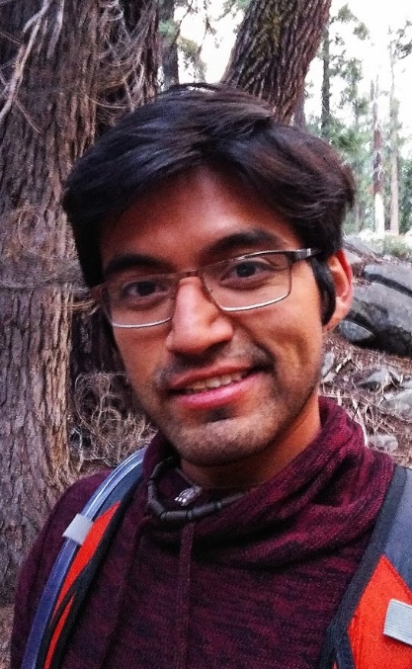
TEAM MEMBERS
Martin Mendez Ruiz
Current Semester:
2nd semester of Digital Engineering
Past Studies:
B.Sc. Telecommunications and Microelectronics Engineering
Skills:
Programming skills: Java, Python, C++, HTML, CSS.
1 year of project work experience
Personal motivation:
Improve and put in practice my programming skills
Get to know the steps to create a software product
Learn project management skills

Slide 6


ABOUT OUR PROJECT
Money control:
Overview of your personal monthly expenses
Calculating balance
Manual categorization of expenses
Ability to check your balance at any time
Show the statistics and history
Budget planning

Slide 7

TEAM ROLES AND RESPONSIBILITIES
Product owner
Marcel Öfele
Scrum Master
Defining the vision
Decision maker regarding features
Prioritizing needs
Accept or reject work results
Martin Mendez Ruiz
Clearing obstacles
Ensuring a good relationship between the team
Protecting the team from outside interruptions and distractions
Create good environment
Development Team
Everyone
Self-organizing
cross-functional
Deliverables of the product
Notes:
make sure the goals are clear and the vision is aligned with the objectives
decision maker regarding what features the product will have
remove challenges faced by the team
Establishing an environment where the team can be effective

Slide 8
FLEXIBILITY
STEP 01
Weekly discussions with customer about changes in the product
Flexible distribution of the workload within the team
STEP 02

Slide 9







COMMUNICATION
Github
Weekly
Team meetings

Slide 10
Thank you for your attention

